Slide 1
AE Exam Review

Slide 2
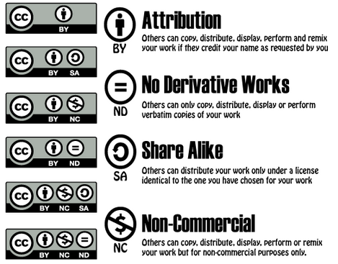
Copyright Symbols

Slide 3
Custom Render Settings
Quality
Resolution
Frame Blending
Motion Blue
Time Span
Frame Rate

Slide 4
Composition Settings

Slide 5
Composition Panel
Adjust view to 33%
Adjust resolution to 50%

Slide 6
Reverse Animation

Slide 7
Blend Modes

Slide 8
Audio Sources – Reduce Level / Trim Length

Slide 9
Text Options
Tracking
Leading
Kerning
Sup/Sub Script
Fill
Stroke

Slide 10
Layers Identification Shape/ Motion

Slide 11
AI Importing / Convert to Shape

Slide 12
Motion Blur/3D

Slide 13
Animations – show text animations

Slide 14
Safe Area Title vs Action

Slide 15
Pics Balance/Rule of Thirds/Scale

